Slide 1


Enzo Magalhães
12/01/2022

Slide 2

Outline
Executive Summary
Introduction
Methodology
Results
Conclusion
Appendix

Slide 3
Executive Summary
The main research environment was based on Python Jupyter Notebooks and its many data visualization libraries such as Matplotlib, Pyplot, Folium and Dash, for the machine learning modelling we used mainly scikit-learn built-in models.
The research outcomes can be summarized as those key main points:
There is a visible trend that as time passes the successful landings yearly rate increases, which indicates a constant improvement of SpaceX performance
SpaceX has been increasing both the orbit type range and the payload mass of the rockets over time.
The company success rate varies a lot depending on the orbit the rocket is launched
Machine learning modelling was not very successful with a visible tendency of predicting success most of the time. That is probably caused by the company consistent increase in success rate over time.

Slide 4
Introduction
This study was made with the objective to archive the goal of exploring SpaceX spatial flights attempts data and extracting any possible information that we could mine that could spot the relationship of the features and the mission outcome and, finally, find ways of optimizing the flights and increase the landing success rate.
The main Questions considered to lead the research efforts were:
What are the relationships between the launch data and the mission possible outcome?
Can we predict the success probability of a mission based on its flight data?
How can we increase the success rate of SpaceX flights?

Slide 5


Slide 6
Methodology
Executive Summary
Data collection methodology:
The data was downloaded using the SpaceX official data API and scraped from Wikipedia SpaceX page.
Perform data wrangling
After we gathered the data and formatted it to a pandas dataframe, we replaced payload mass missing values and created a binary Class feature that tells if the landing was successful or not
Perform exploratory data analysis (EDA) using visualization and SQL
Perform interactive visual analytics using Folium and Plotly Dash
Perform predictive analysis using classification models
How to build, tune, evaluate classification models

Slide 7
Data Collection
The two data collection sources were the public SpaceX API were we downloaded their company flights history, and Wikipedia SpaceX flights page were the scraped the table data out of it.
SpaceX has a public API that anyone can use and we downloaded the rocket launches data from there, the complete API documentation is given below.
API documentation: https://github.com/r-spacex/SpaceX-API/tree/master/docs#rspacex-api-docs
We also collected more data from their Wikipedia launches page . We used web scraping techniques to extract the information we wanted.

Slide 8
Data Collection – SpaceX API
The direct link for the whole dataset: "https://api.spacexdata.com/v4/launches/past"
The API response data is in json format so we had to parse it to pandas dataframe and do a little formatting. The full code used to collect the data is in the link below:
Full code: https://github.com/enzoMagalhaes/ibm-data-science-capstone/blob/master/data_collection_dxVEEiD3x.ipynb
url: https://api.spacexdata.com/v4/launches/past
request
Client
API
Response
(Flights data)

Slide 9
Data Collection - Scraping
Link of the web page that was scraped: https://en.wikipedia.org/w/index.php?title=List_of_Falcon_9_and_Falcon_Heavy_launches&oldid=1027686922
The collected data on the page consists on a table where each row was a different flight. We used Python and BeautifulSoup to perform the scraping. The full code used in the research is given below.
Full code :https://github.com/enzoMagalhaes/ibm-data-science-capstone/blob/master/Data_Collection_with_Web_Scraping_7iMXet0wB.ipynb
url: https://en.wikipedia.org/w/index.php?title=List_of_Falcon_9_and_Falcon_Heavy_launches&oldid=1027686922
request
Client
Wikipedia
Response
(Page HTML)

Slide 10
Data Wrangling
The processing data was very simple. After we had the formatted dataframe ready, we replaced the payload mass missing values with its mean and we summarized the landing outcome by creating a binary column called "Class" which tells if the landing was a success or not.
The full code of the data wrangling process can be found below:
https://github.com/enzoMagalhaes/ibm-data-science-capstone/blob/master/EDA_cxVLV8cPM.ipynb

Slide 11
EDA with Data Visualization
In the exploratory data analysis with data visualization phase we mainly used catplots, scatterplots and lineplots to visualize relationships between variables in the dataset.
Full code:
https://github.com/enzoMagalhaes/ibm-data-science-capstone/blob/master/jupyter-labs-eda-dataviz_h0EFiq3MY.ipynb

Slide 12
EDA with SQL
In this phase we used SQL to explore the data by mainly (all queries can be found in the link below):
Displaying the names of the unique launch sites in the space mission
Displaying the total and average payload mass carried by boosters launched by NASA (CRS)
Get the first successful launch date
Find out what boosters had successful a successful landing with a with heavy payload( 4000-6000 mass)
List the total number of successful and failure mission outcomes
List the names of the booster versions which have carried the maximum payload mass
List failed drone ship launches
And count the landing outcomes
Full code:
https://github.com/enzoMagalhaes/ibm-data-science-capstone/blob/master/EDA_with_SQL_PqjRPWvEM.ipynb

Slide 13
Build an Interactive Map with Folium
In this phase we used Folium to have a geographical notion of the flights launches. The visualizations were based on plotting circles and naming them with markers in the respective launch site areas in the map so we can highlight and have a clear view of the locations where SpaceX activity is.
In the last maps we used marker clusters so we can see the concentration of SpaceX activity in some space stations in Florida and California.
Full code:
https://github.com/enzoMagalhaes/ibm-data-science-capstone/blob/master/Interactive_Visual_Analytics_with_Folium_lab_9GrhmUkXX.ipynb

Slide 14
Build a Dashboard with Plotly Dash
Summarize what plots/graphs and interactions you have added to a dashboard
In this phase we build a interactive dashboard so that users can actively play with the data and understand its characteristics. In the dashboard we used:
A pie plot of the distribution of the success rate of flights so that users can know what launch sites had the most successful launches.
A interactive scatter plot between the payload mass and the flight outcome so we can visualize the relationship between payload mass and flight success.
Full code:
https://github.com/enzoMagalhaes/ibm-data-science-capstone/blob/master/spacex_dash_app.py

Slide 15
Predictive Analysis (Classification)
In this last research phase we tried to find a optimal classification model to predict the landing outcome based on the flight data such as payload mass, orbit, launch site and etc.
We used various sci-kit learn machine learning models with different parameters using grid search with the objective to find the optimal performance. The models used in the research were K nearest neighbors, support vector machines, decision trees and logistic regression.
The main evaluation methods in the study were the accuracy score and the confusion matrix. After experimenting with those models and fine tuning them we have found even though the models had different accuracy scores in the training set, the SVM, logistic regression and KNN performed evenly in the test set, with an accuracy of around 83.3%.
Full code:
https://github.com/enzoMagalhaes/ibm-data-science-capstone/blob/master/Machine_Learning_Prediction_3QXVPVTHN.ipynb

Slide 16
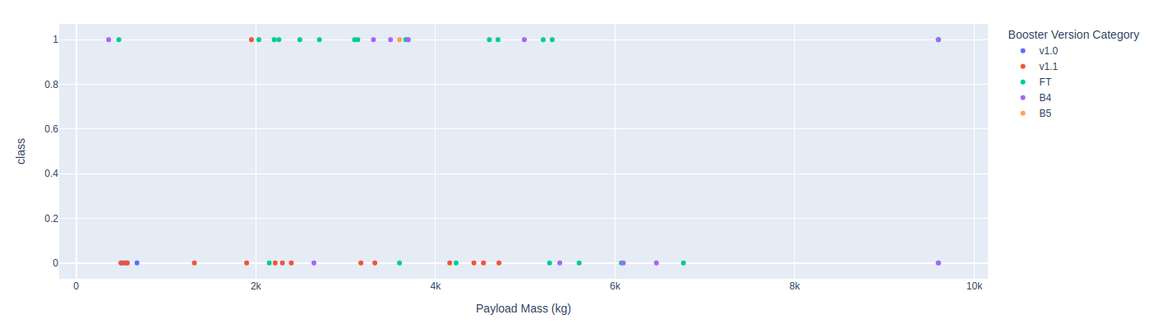
Results
When exploring the data we have found direct relationships between the possible outcome and features like orbit type, payload mass and launch site
We have built predictive models that are very good to classify a good outcome but not as good to a bad one

Slide 17


Slide 18
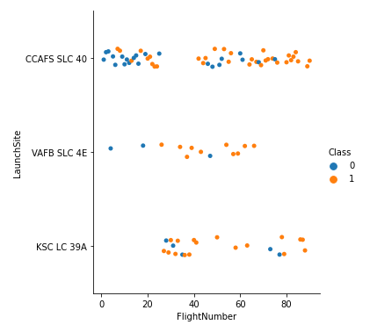
Flight Number vs. Launch Site
In the plot below we see that to all launch sites there is a tendency of increasing success chance as the flight number increases which suggests that SpaceX is gradually improving their overall success rate.
We can also see that "VAFB" has not been used as a launch site for a while now.

Slide 19
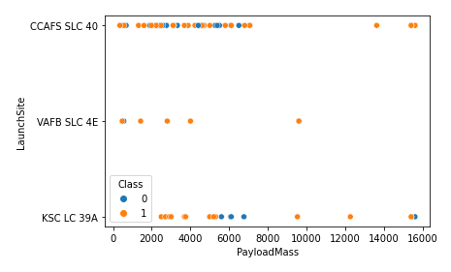
Payload vs. Launch Site
In this plot we can clearly see that "VAFB" is not used for launches with payload masses bigger than 10000.

Slide 20
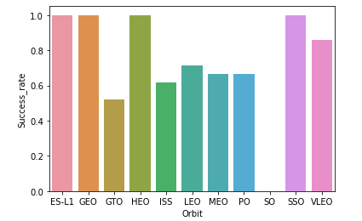
Success Rate vs. Orbit Type
With this plot we can easily see that success rate depends a lot on the orbit type, some orbit like ES-L1, GEO, HEO and SSO have a 100% success rate while others have roughly 60%.

Slide 21
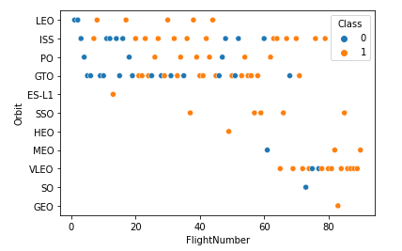
Flight Number vs. Orbit Type
With this plot we can realize that the first launches of SpaceX were concentrated in the 5 first orbits listed in the plot and, as flight number increases, the number of orbits used for the rocket launches increased.

Slide 22
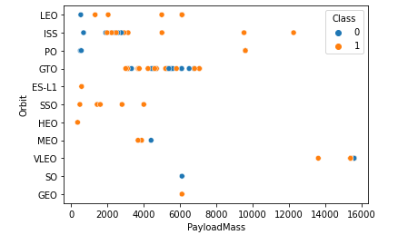
Payload vs. Orbit Type
In this plot we can see that most of the flights listed had a payload mass below 8000 and the majority of the flights between mass 4000 and 8000 were performed in the GTO orbit.
We can also point out that the few launches with a payload mass bigger than 10000 were mostly successful.

Slide 23
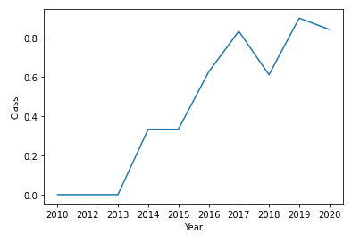
Launch Success Yearly Trend
In this plot we can easily see the trend of increase in success rate as time passes, which suggests that SpaceX is improving their launch performance over time.

Slide 24
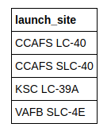
All Launch Site Names
This is the query result of all launch sites used by SpaceX

Slide 25
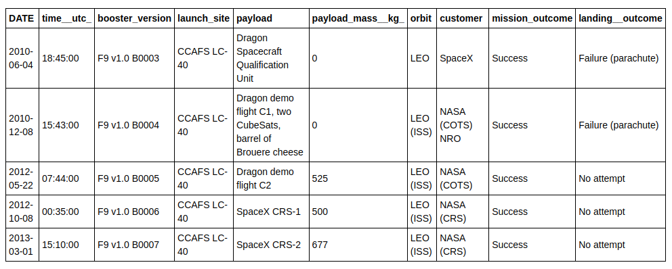
Launch Site Names Begin with 'CCA'
Each row of this table is a different launch data and as we can see the "CCA" launch site has been using similar booster versions and we can also notice an increase in payload mass as time passes

Slide 26
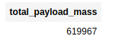
Total Payload Mass
This is the total payload mass carried by all SpaceX launches ever.

Slide 27
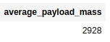
Average Payload Mass by F9 v1.1
This is the average payload mass carried by SpaceX launches that used booster version F9 v1.1

Slide 28
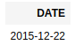
First Successful Ground Landing Date
This is the date of the very first successful landing that a SpaceX rocket has ever performed

Slide 29
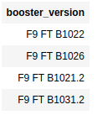
Successful Drone Ship Landing with Payload between 4000 and 6000
Those are the booster versions that have successfully landed on a drone ship and have a payload max between 4000 and 6000

Slide 30
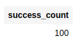
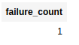
Total Number of Successful and Failure Mission Outcomes
This is the number of successful and failed missions performed by SpaceX of 101 missions performed.

Slide 31
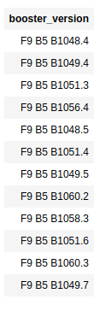
Boosters Carried Maximum Payload
Those are the names of the booster versions that have carried the heaviest payload mass registered until then by SpaceX

Slide 32
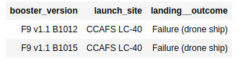
2015 Launch Records
Those are the launches performed by SpaceX in 2015

Slide 33
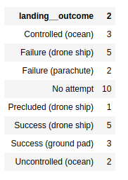
Rank Landing Outcomes Between 2010-06-04 and 2017-03-20
This is the count of each landing outcome of all the SpaceX launches performed between 2010-06-04 an 2017-03-20

Slide 34


Slide 35
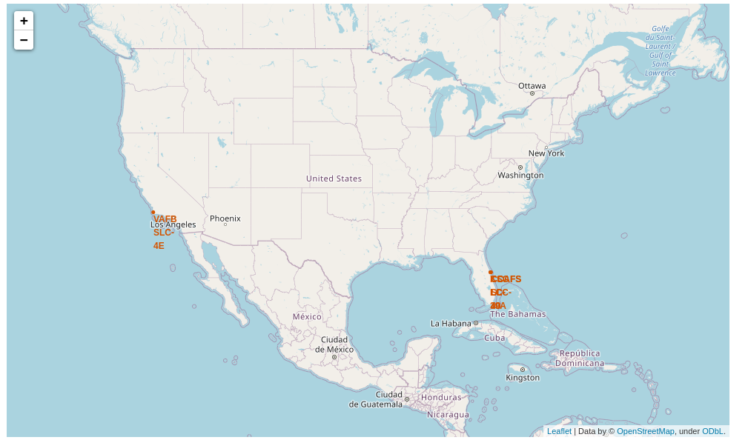
Geographical location of launch sites
In this geographical location plot we can see that SpaceX launch sites are in the south of the United States and in a similar latitude

Slide 36
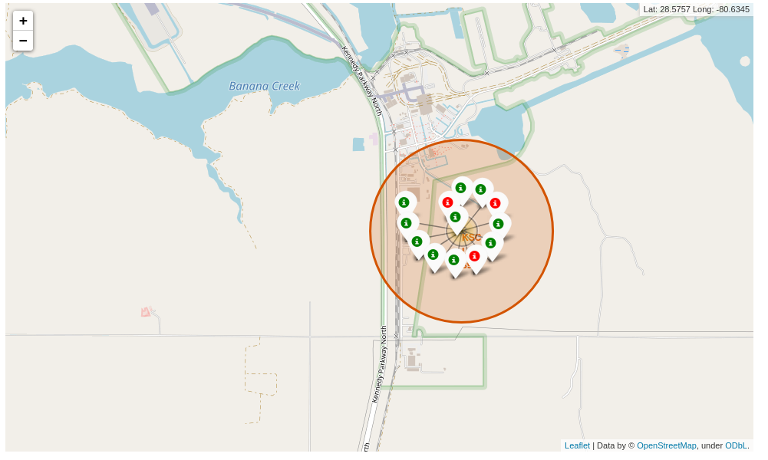
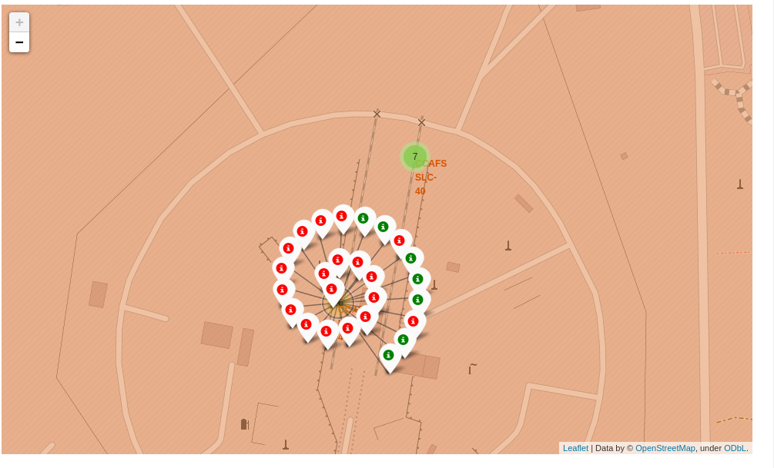
Location of labeled success/failed launches
In this plot we can see the location of the launches labeled as green when successful or red if not.
Here we can realize that most launches are performed in the same place and most CCAFS launches failed

Slide 37
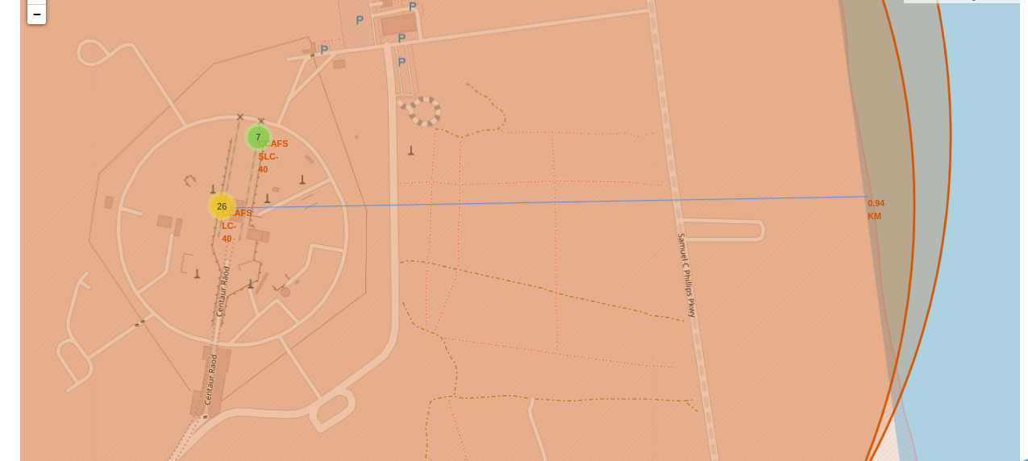
Distance between the base and the coast
As we can see the launch site is located near the coast, with a distance of around 1 kilometer. That can also be easily observed in the previous maps where the sites are located near the sea

Slide 38


Slide 39
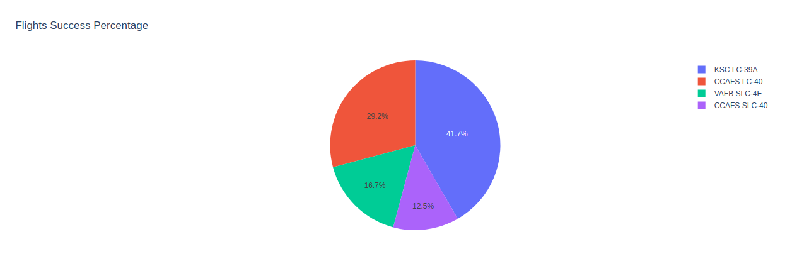
Launch site x success outcome distribution
With this visualization we can confirm a unequal distribution of successful outcomes and launch site where sites like "KSC LC-39A" and "CCAFS LC-40" together hold almost 70% of the total successful missions

Slide 40
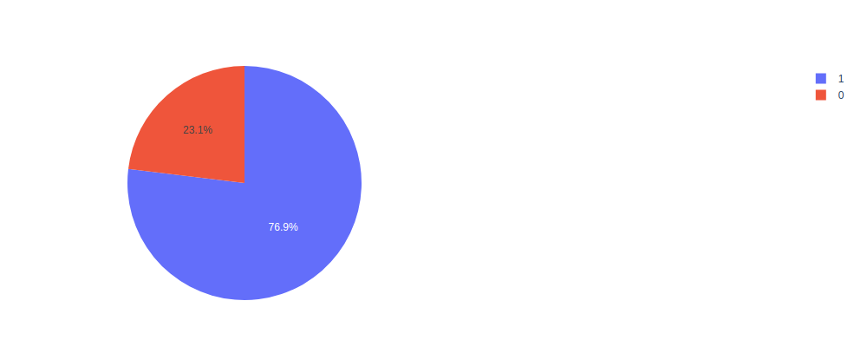
KSC LC-39A Success ratio
In this dashboard visualization we can see that in the KSC launch site almost 80% of the flights were successful, and that indicates a relationship between the launch site and the success probability

Slide 41
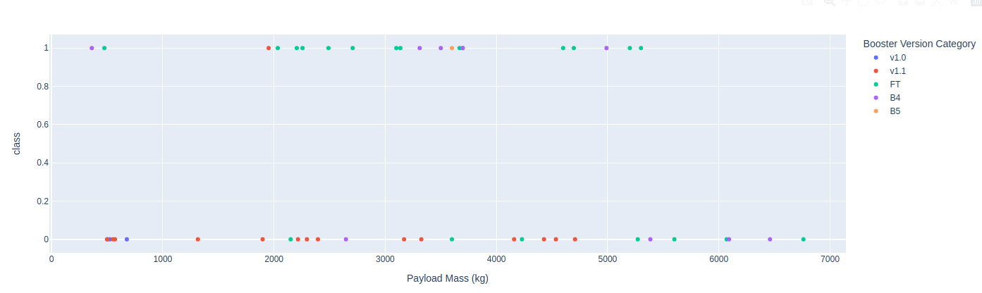
Payload mass x Outcome
In this plot we can visualize that the range of payload mass which has the most successful outcomes is between 2000 and around 3800 and failed missions are spreaded across all the payload mass axis

Slide 42


Slide 43
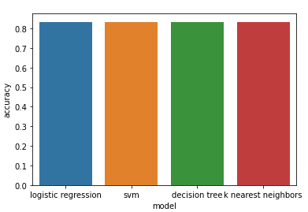
Classification Accuracy
When testing all the models we have found out that although they have different accuracy score in the training set, they have basically the same accuracy in the test set.

Slide 44

Confusion Matrix
All the studied models had this same confusion matrix that perfectly predicts the outcome of the successful flights but it does not do a good job at predicting flights that will fail.

Slide 45
Conclusions
There is a visible trend that as time passes the successful landings yearly rate increases, which indicates a constant improvement of SpaceX performance
SpaceX has been increasing both the orbit type range and the payload mass of the rockets over time.
The company success rate varies a lot depending on the orbit the rocket is launched
Machine learning modelling was not very successful with a visible tendency of predicting success most of the time. That is probably caused by the company consistent increase in success rate over time.

Slide 46
Appendix
All the notebooks used in the research can be found in the link:
https://github.com/enzoMagalhaes/ibm-data-science-capstone

Slide 47


